Slide 1
Phase 2 Java Jun21 Grp 3 Internship Portal

Slide 2
Team Members:
Suchitra Kadolkar
Rushikesh Tapdiya
Rohan Kulkarni
Sachin Kulkarni
Dimuthi Tharaka
Rishitha Vejalla
Roshini Uppati

Slide 3
Index
Introduction
Problem Statement
Proposed System and Features
Hardware and Software Requirements
Diagrams
Code Coverage
Conclusion
Future Enhancement

Slide 4
Introduction
The system is designed to help students find internship for their profiles easily. Students can see various job profiles on one page itself and can apply for the roles. Companies can register and post their jobs profile here itself.

Slide 5
Problem Statement
Design a system to help students where they can search and apply for jobs, and companies can also find suitable interns for their job profiles.

Slide 6
Proposed System
Admin-
Entire control over the system.
Company Admin-(many profiles 1-many relationship)
Add Company Job Profile.
Update the profile
Delete the Profile
See the users listed for their profile.
Intern-
Add his/her information
Retrieve the available profiles.
Apply for any profile.

Slide 7
Hardware and Software Requirements
Spring Boot, Spring, MySQL, Maven, HTML5, CSS 3,Thymeleaf,Github, Core JAVA.

Slide 8
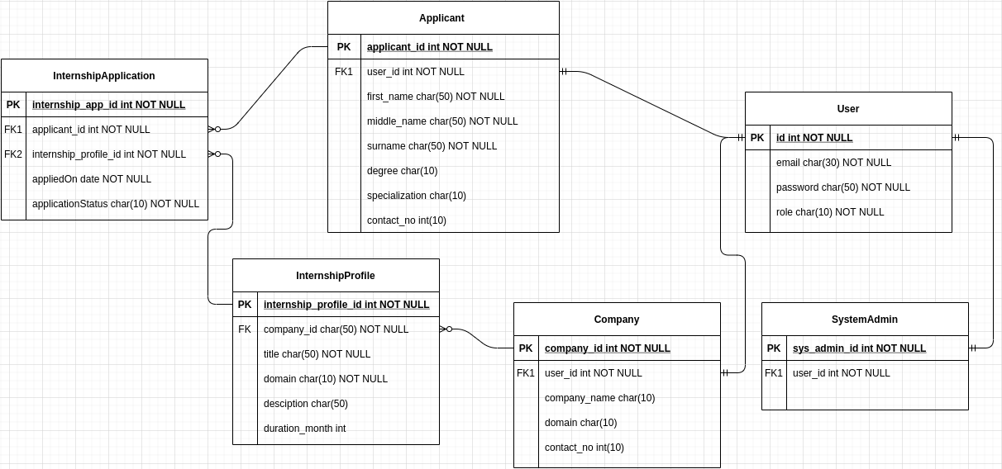
ER Diagram

Slide 9
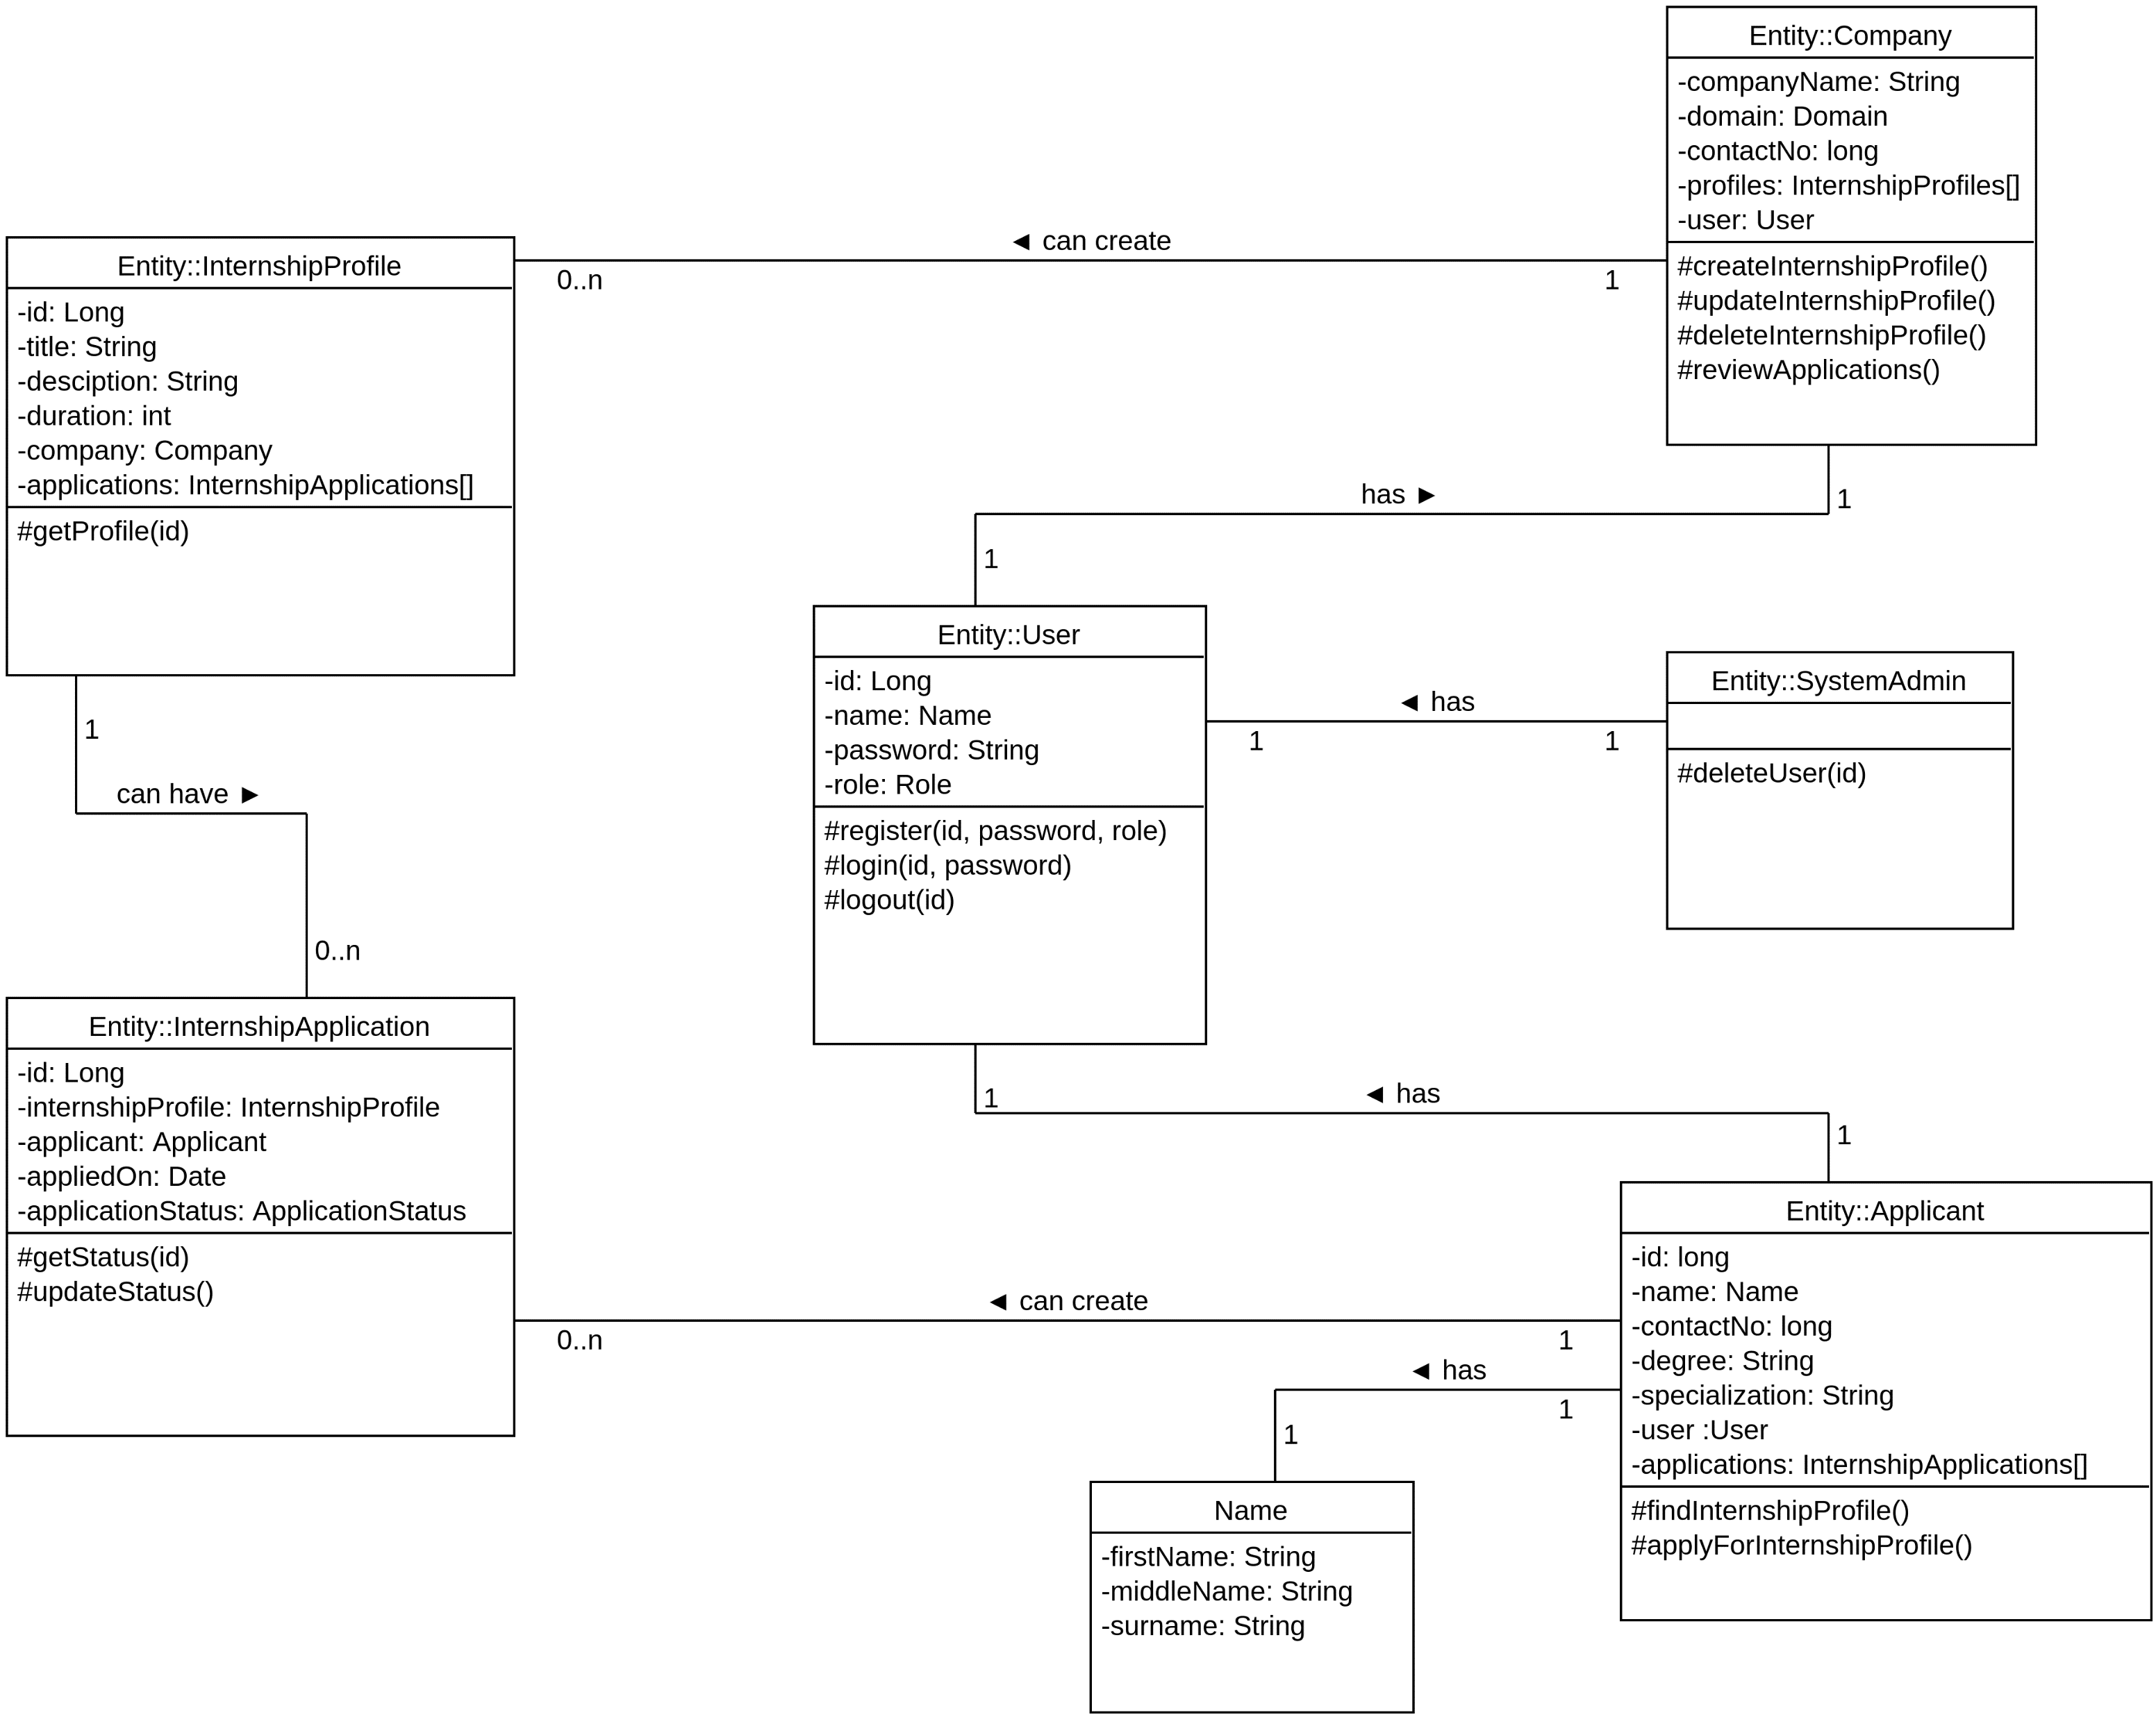
Class Diagram

Slide 10
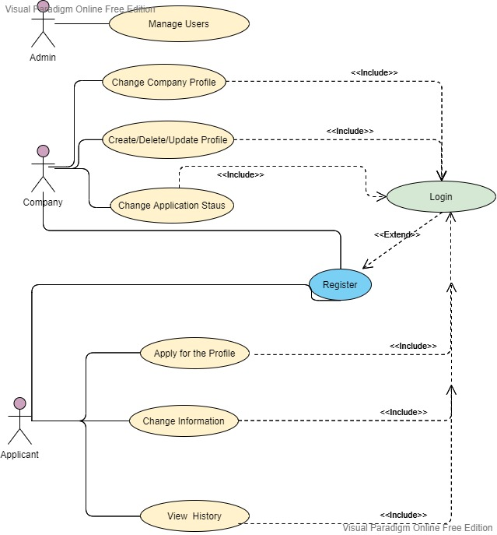
Use Case Diagram

Slide 11
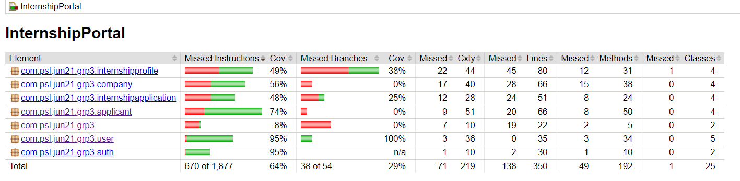
Code Coverage

Slide 12
Conclusion
Therefore, the proposed system will enhance the recruit process for both companies and applicants.

Slide 13
Future Enhancements
A recommender system for the user based on his past experiences and education.
AI System for companies to sort find interns suitable for their jobs.
More Complex and Interactive User Interface.

Slide 14

Thank You!

